Slide 1

Arduino Workshop
Hosted by: Gustavo Correa
Location: Creat’R Lab @ UCR
Today’s Date: April 25th, 2017
Schedule: Weekly, 4/25/17 - 5/30/17

Slide 2
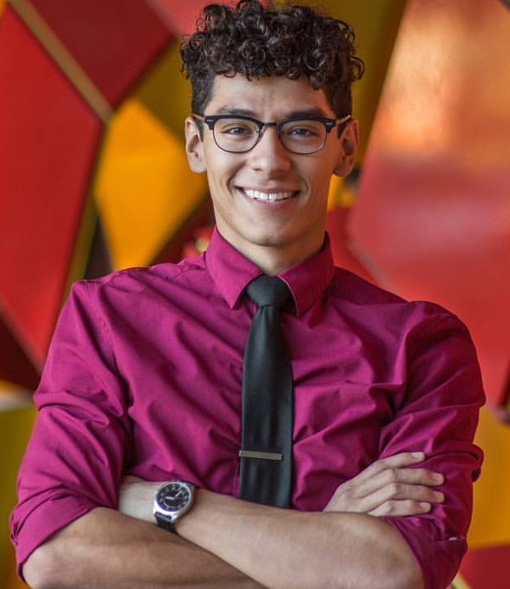
About me!
2nd year Computer Engineering student
Co-project manager for IEEE
I love to make stuff!
Got a lot of my project experience from going to hackathons.
Raving is cool. It’s even cooler when you can wear LED costumes that you’ve made :D
Website: gustavojcorrea.com

Slide 3
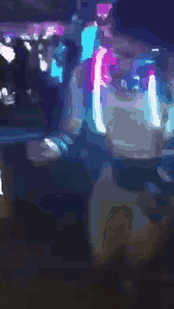
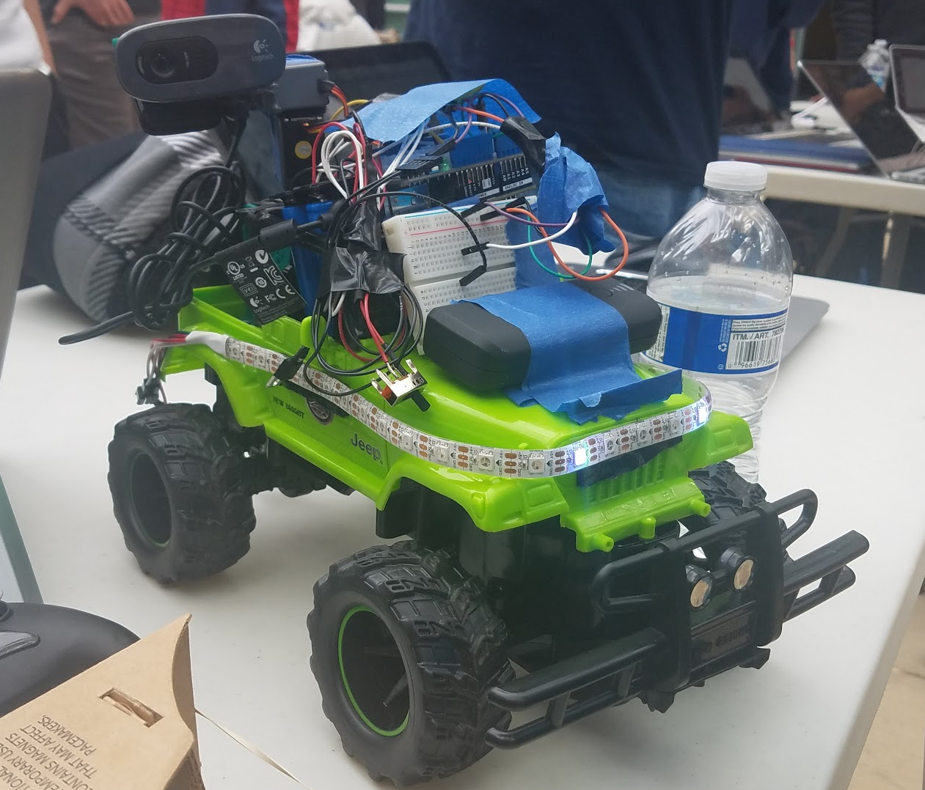
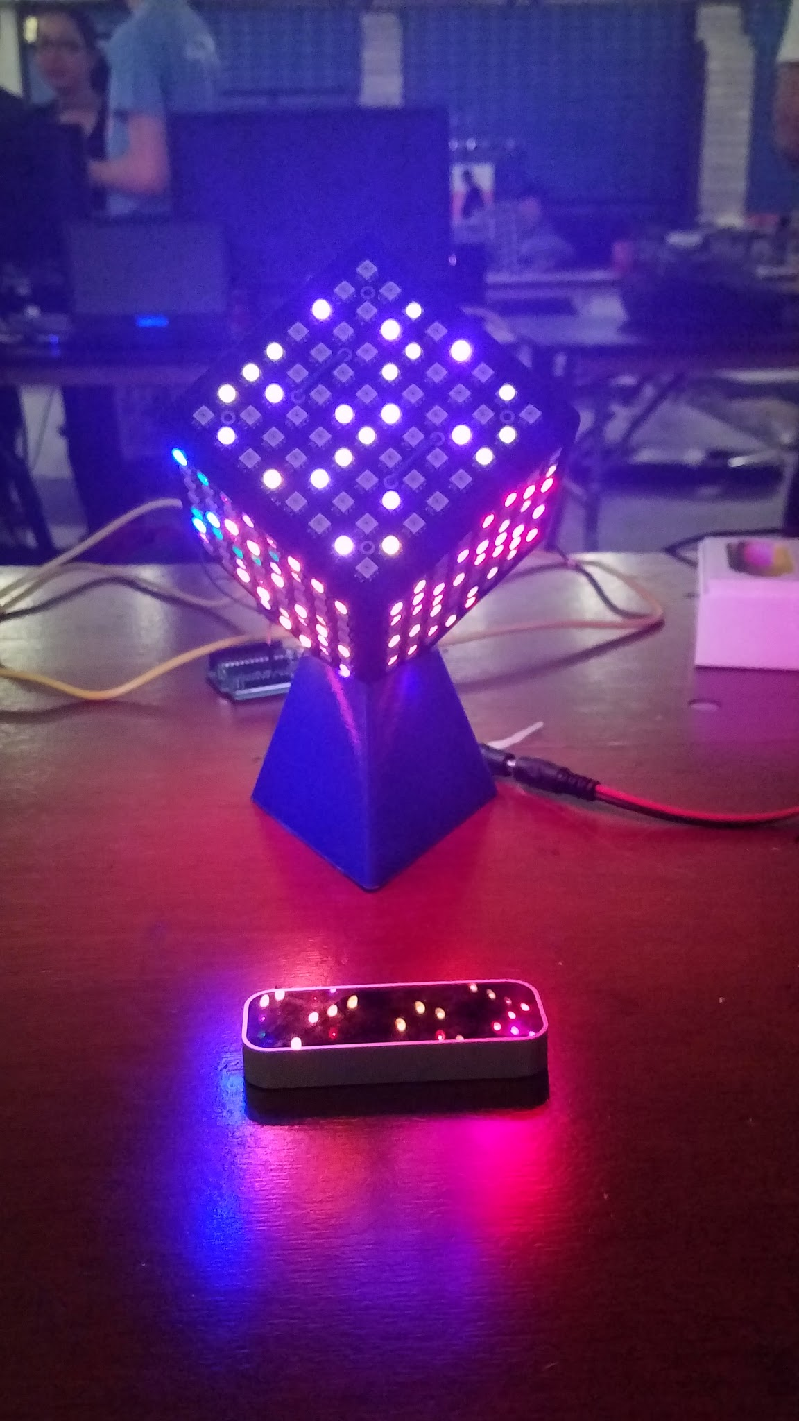
My Projects!

Slide 4
Overview
What is Arduino??
What can you do with Arduino?
Workshop Style
Getting familiar with the Arduino IDE
Activity!

Slide 5
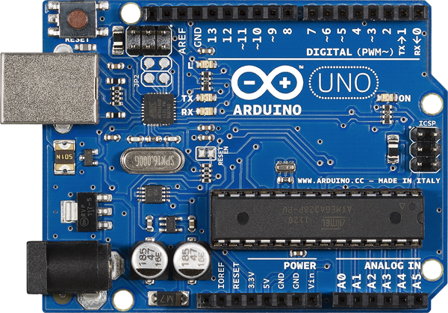
What is an Arduino?
The Arduino is a microcontroller board.
A microcontroller
senses the environment by receiving inputs from add-on sensors, and
affects its surroundings by controlling lights, motors, and other actuators
The Arduino is based on the Atemga328P microcontroller

Slide 6
Sooo what can I do with it??

Slide 7
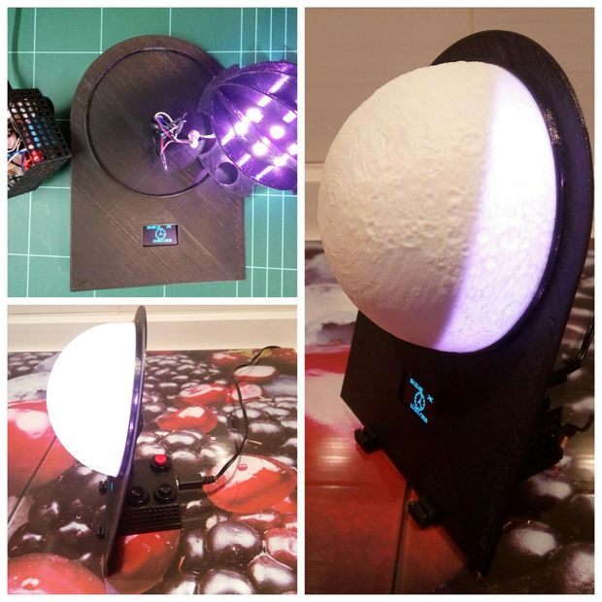
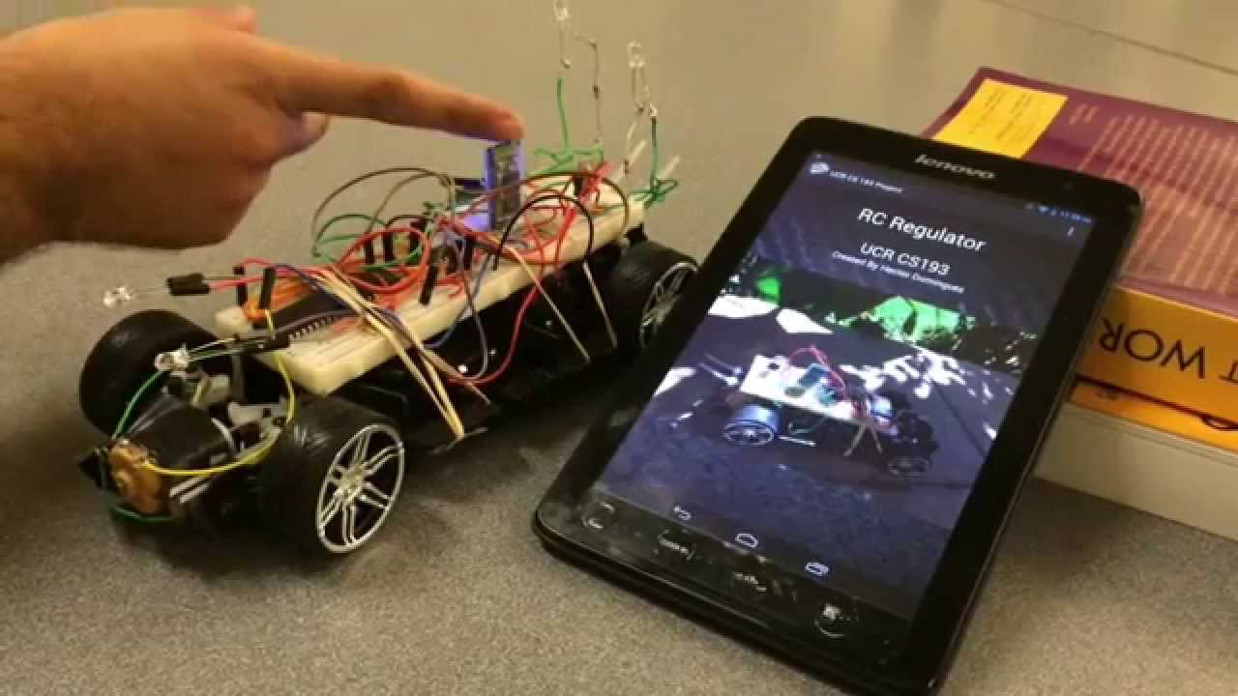
What can you do with Arduino?
Robots
Hackathon projects
Class Projects
Interactive Art

Slide 8
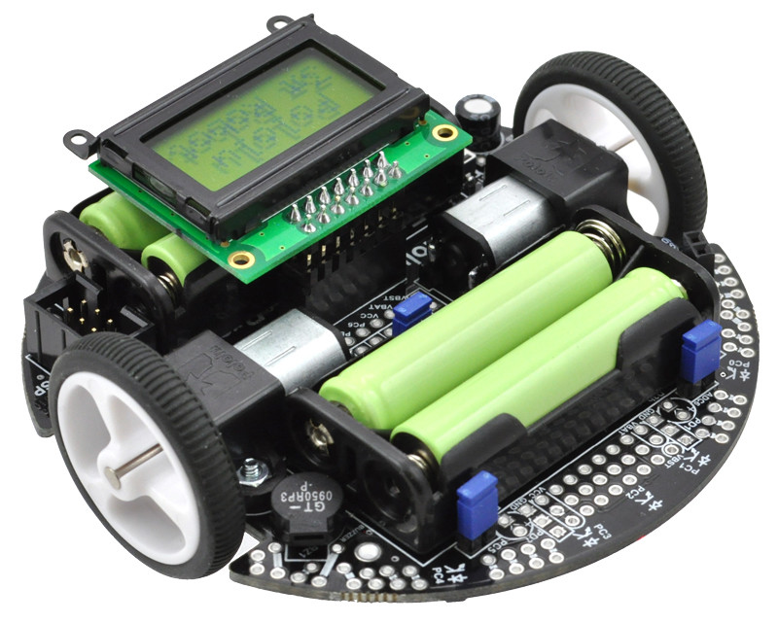
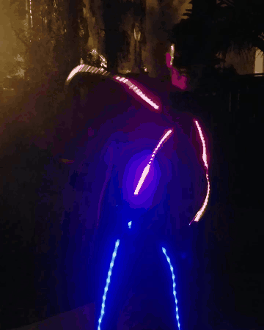
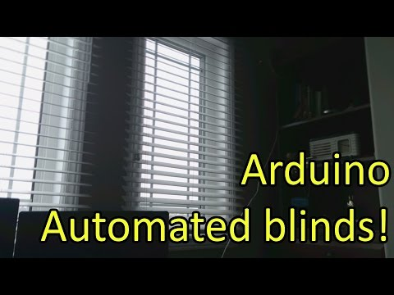
What else can you do with Arduino??
Internet of Things and Home Automation
Robots - Micromouse
Costumes/Wearables

Slide 9

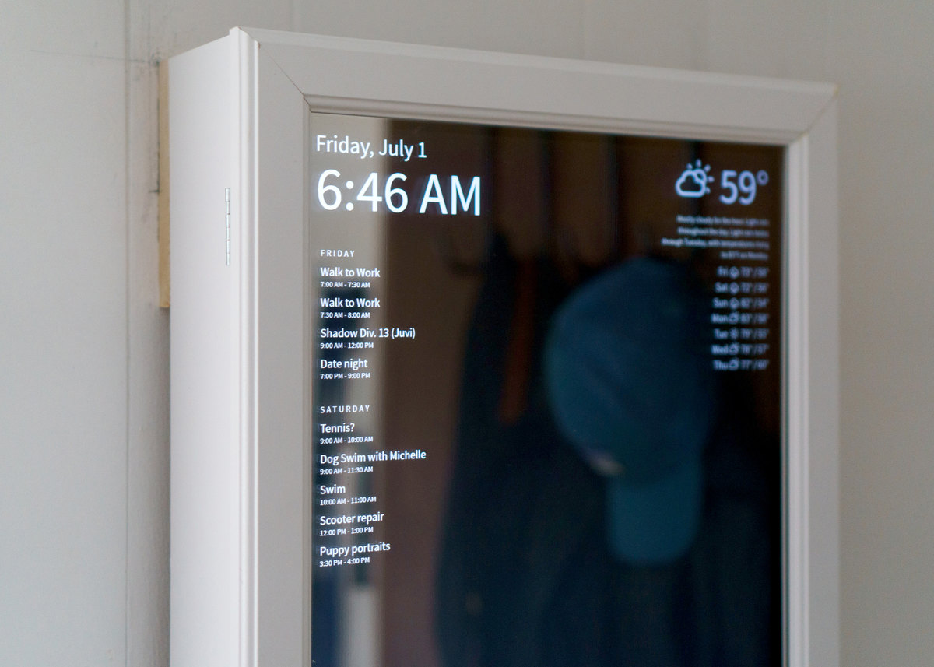
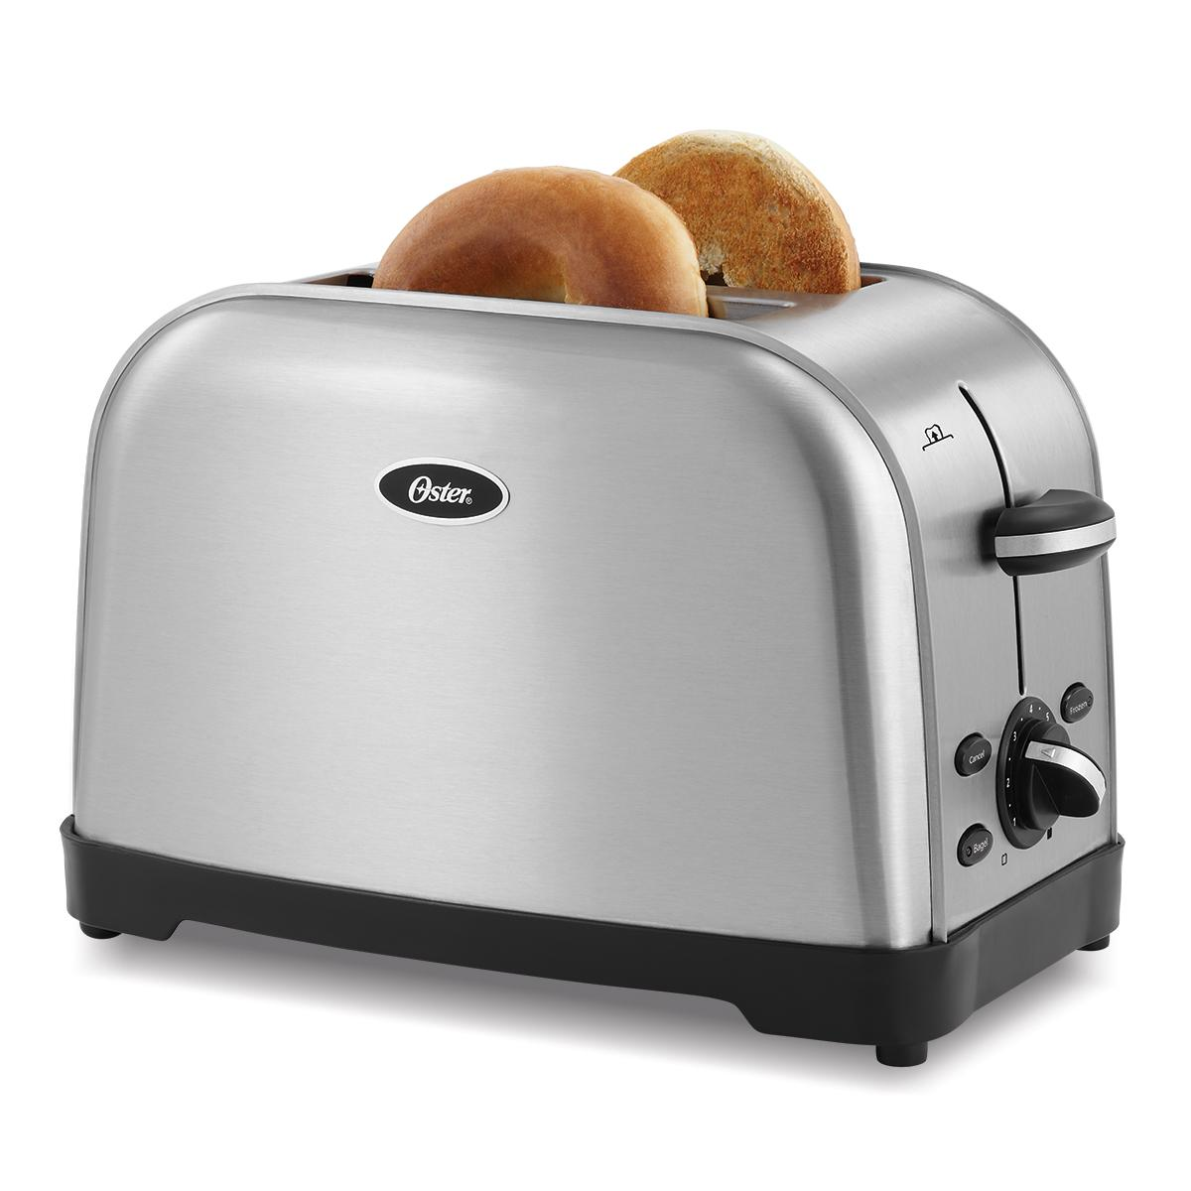
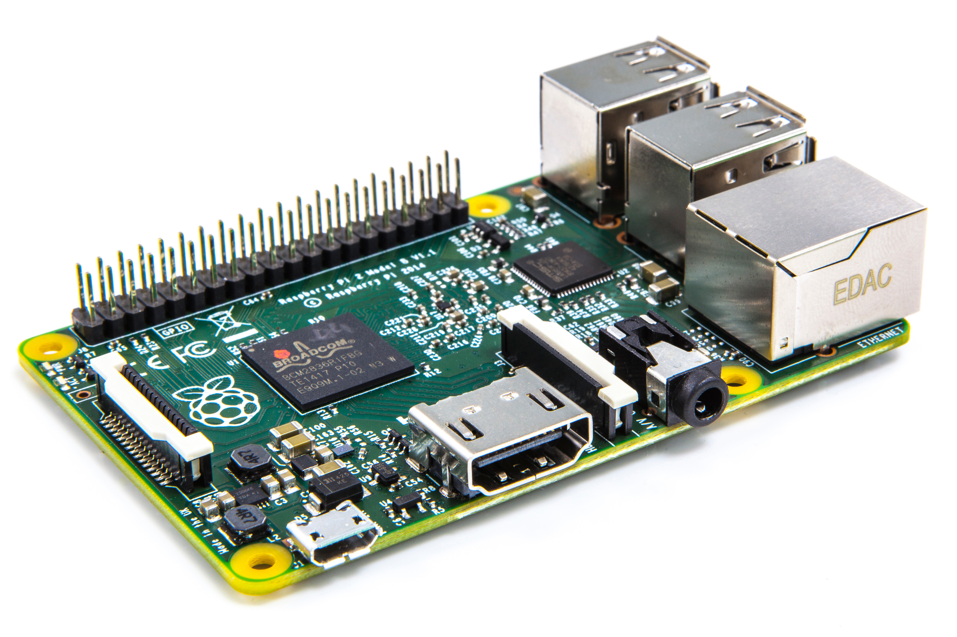
Connect the Arduino to more things to make more cool stuff!
Make a smart mirror to control a toaster !

Slide 10
What is this workshop about?!

Slide 11
Workshop series objectives
Learn Arduino!
Apply concepts in C++ programming to program the Arduino
Make make and make some more
Gain an understanding of Arduino electronics
Combine the Arduino with other Creat’R Lab Resources to make cool things

Slide 12
Workshop Format
Activity Days
Classroom-style presentations
Workshop activities
“Free/open” workshop days
Time to get help with your projects!

Slide 13
Important Requirements

Slide 14
What you’ll need:
Yourself

Slide 15
What you’ll need:
Yourself
Ideas

Slide 16
What you’ll need:
Yourself
Ideas
Laptop

Slide 17
What you’ll need:
Yourself
Ideas
Laptop
Arduino!

Slide 18
Let’s Start!

Slide 19
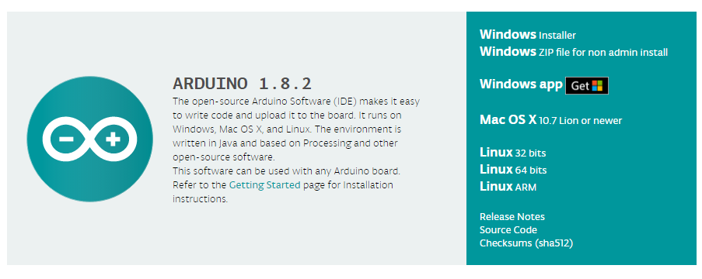
Download and install the Arduino IDE
Link: https://www.arduino.cc/en/Main/Software

Slide 20
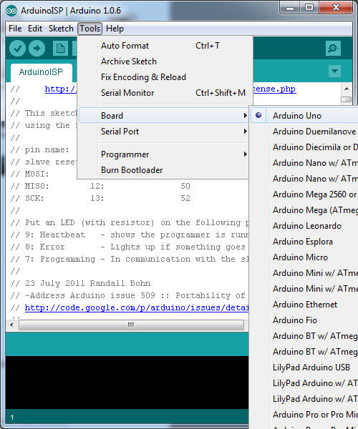
Setting up
the Arduino IDE

Slide 21
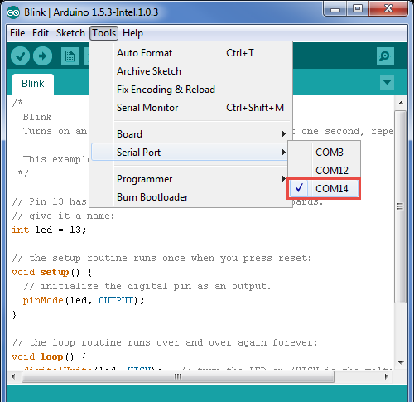
Setting up
the Arduino IDE

Slide 22
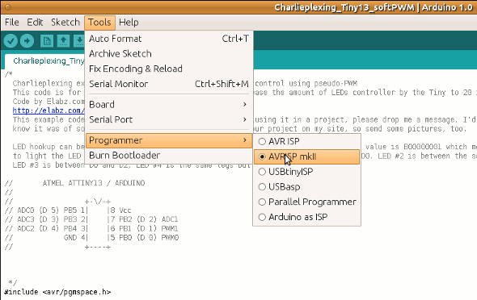
Setting up
the Arduino IDE

Slide 23
Terminology
“Sketch” - program that runs on the board
“Pin” - input or output connect to something
ex) Output to an LED, input from a switch
“Digital” - 1 is High, 0 is Low
“Analog” - range of values (0 - 255 typically)

Slide 24
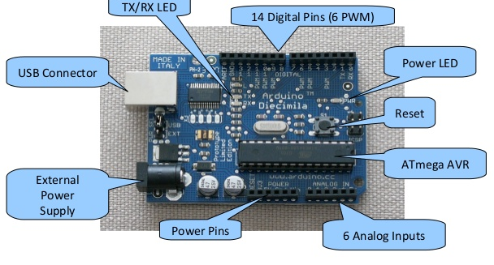
Hardware parts of an Arduino

Slide 25
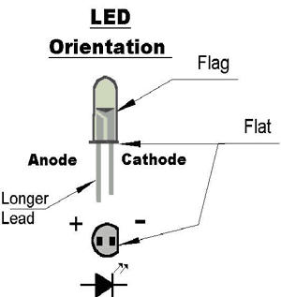
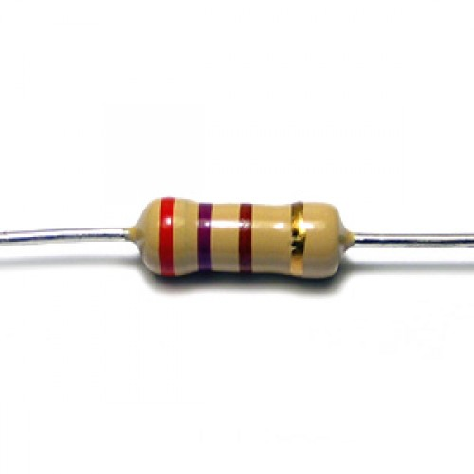
Components
LED
Positive side is the ANODE (long leg)
Negative side is the CATHODE (short leg)
Resistor
330 Ω (Ohm)
Resistance is indicated by the striped color pattern
Orange, orange, brown
Breadboard

Slide 26
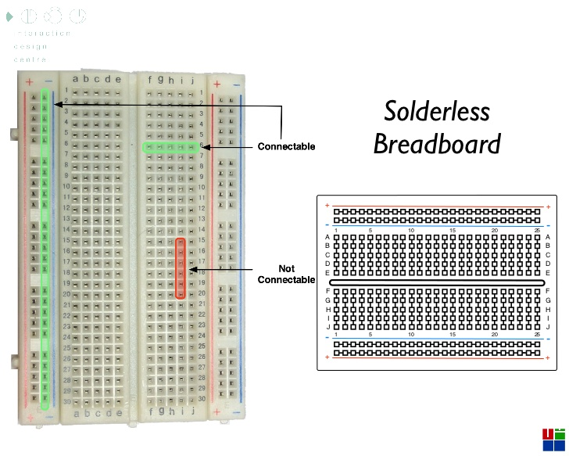
What is a Breadboard?

Slide 27
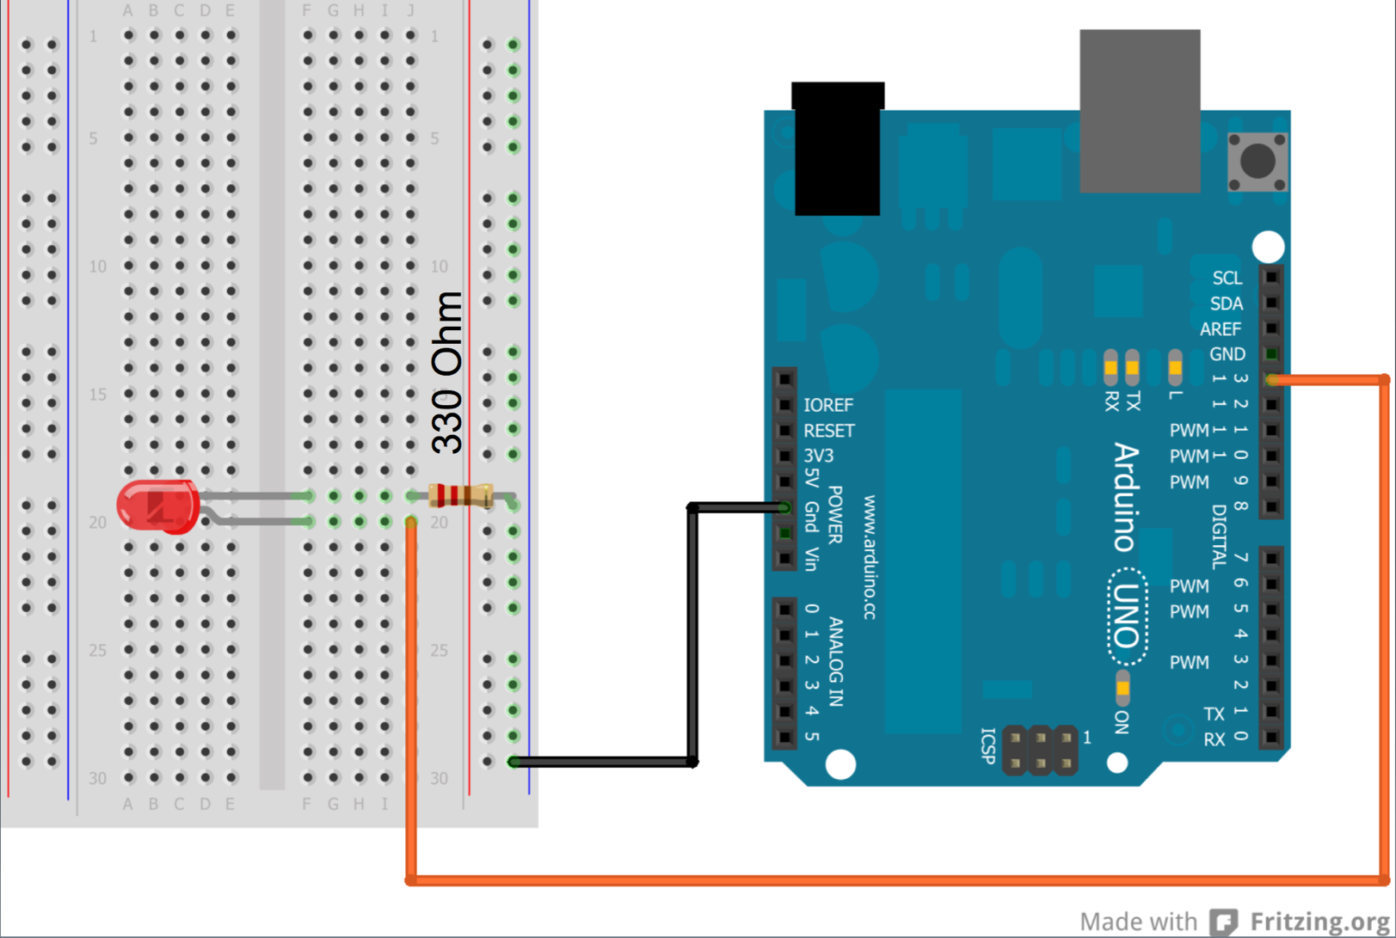
Wiring
Short end
Long end

Slide 28
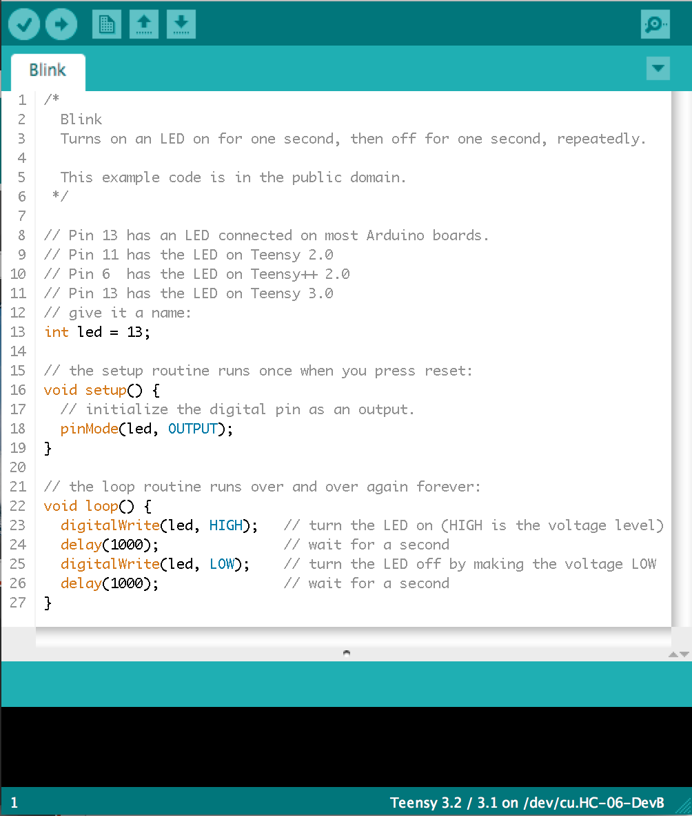
First Arduino Sketch!
File > Examples > Basics > Blink
Verify
Upload

Slide 29
What’s going on in the code??

Slide 30
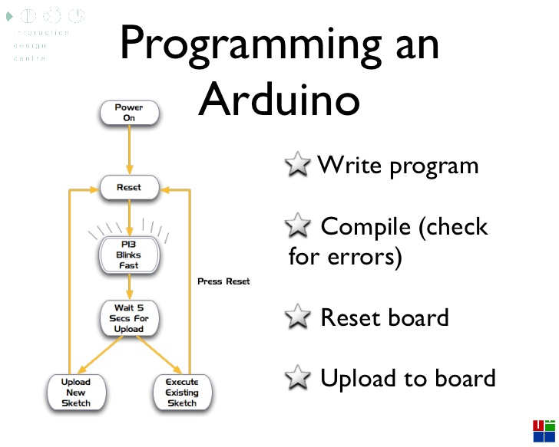

Slide 31
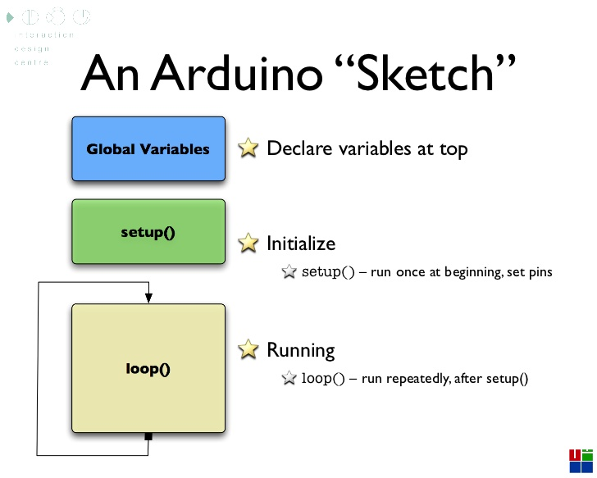

Slide 32
What are variables?

Slide 33
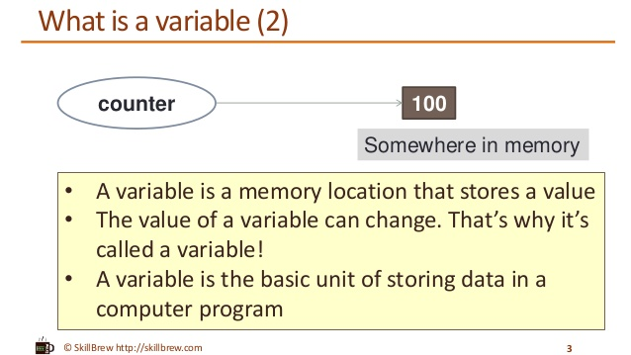

Slide 34
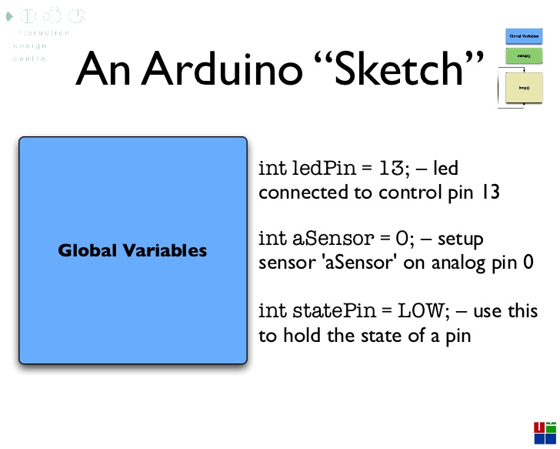

Slide 35
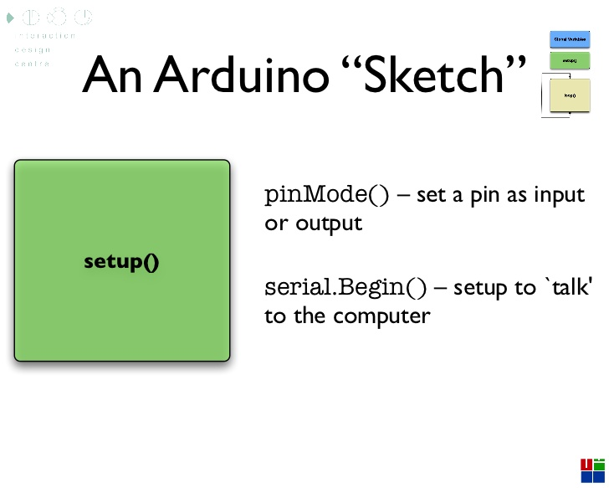
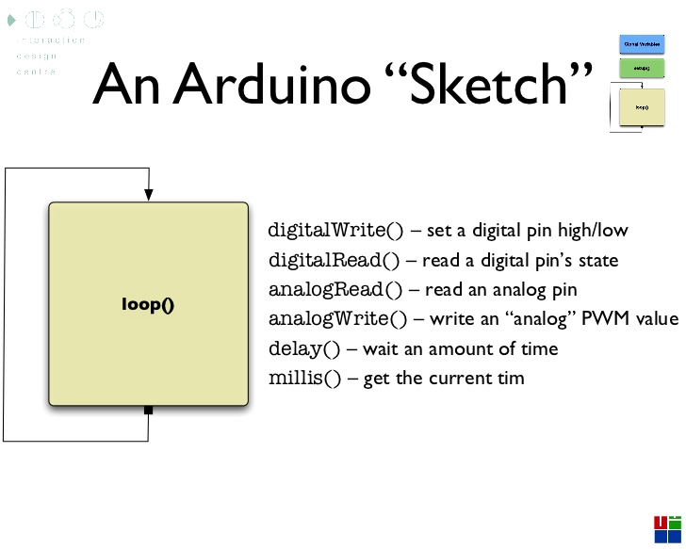
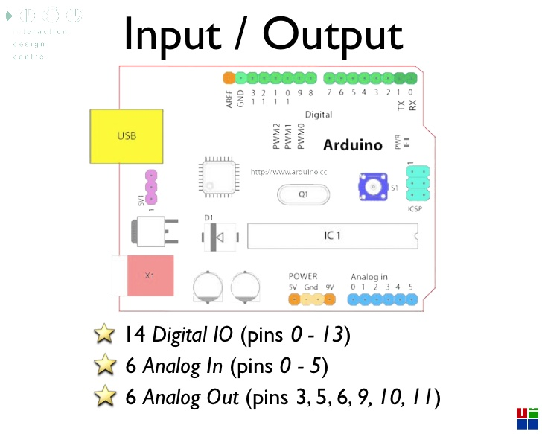

Slide 36
Parts to a variable
Data type

Slide 37
Parts to a variable
Data type
Variable Name

Slide 38
Parts to a variable
Data type
Variable Name
Value

Slide 39
What are functions?

Slide 40
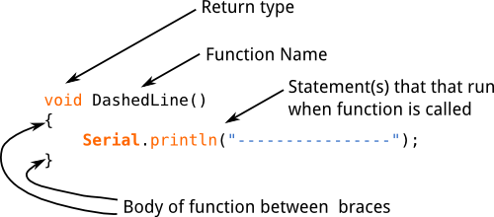
Parts to a function

Slide 43
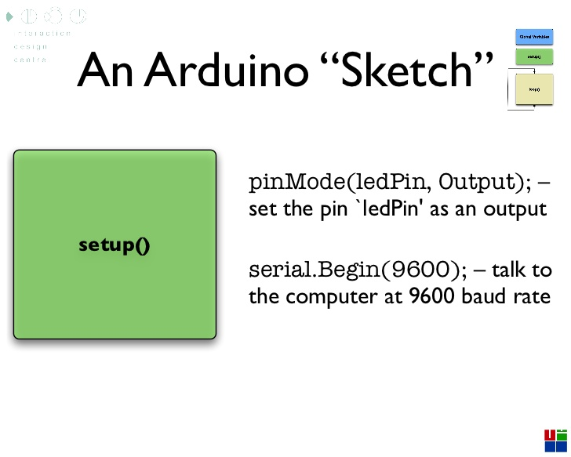

Slide 44
The “Blink” Sketch

Slide 45
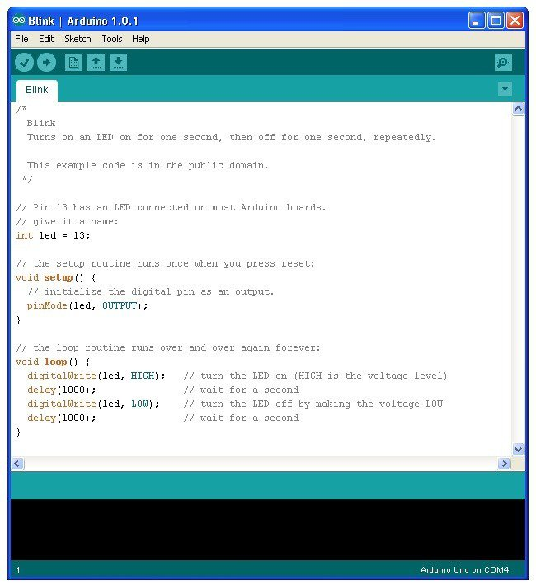

Slide 46
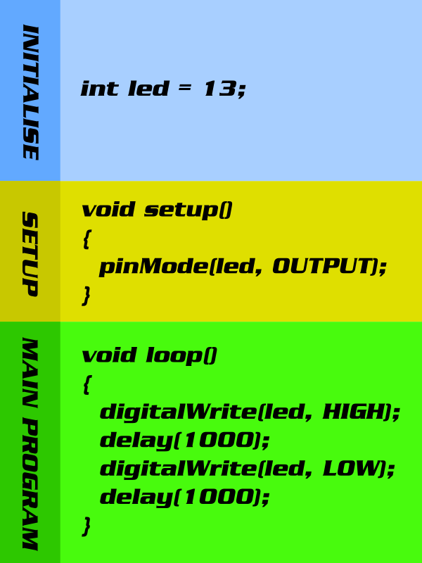

Slide 47
MINIPROJECT !!!

Slide 48
Let’s make a lightshow!
Write a function to make your LED blink on and off
Call it in your main loop
Any ideas of how to make it??
Let’s go to the Arduino IDE

Slide 49
Done!!!
Next workshop date:
Tuesday May 2nd
Thanks for coming!!!

